Slide 1
GRE TEST prep
Intro: GRE setup and resources
Beth Bowman, Ph.D.
VSSA GRE prep course

Slide 2
GRE scores and your grad school application: Do they matter?
Graduate School
  Not required for most biomed programs
    https://docs.google.com/spreadsheets/d/1MYcxZMhf97H5Uxr2Y7XndHn6eEC5oO8XWQi2PU5jLxQ/edit#gid=0
  GRE
    Range (50-100%)
  GPA
  Research experience
When GRE scores really matter
  Competing for fellowships
  When your other credentials aren’t great
  When they are low (<50%)

Slide 3
Familiarization
Format of test and sections

Slide 4
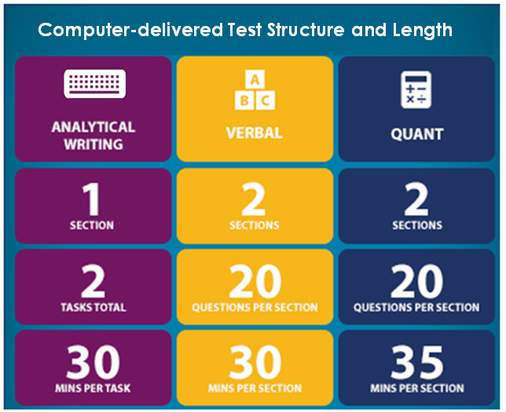
The Computer-delivered GRE® revised General Test
    The test also includes:
    Either an unscored section or a research section that does not count toward the test taker’s scores
      If the test taker gets an unscored section, they will not know which one it is, so they should try their best on all the sections
      If the test taker gets a research section, it will always be last and will be clearly marked
    Approximate total testing time = 3 hours and 45 minutes

Slide 5

GRE® Scores and Score Scales
Three scores are reported on the following scales:
0–6
in half-point increments
130–170
in 1-point increments
130–170
in 1-point increments
    Grad schools care most about your percentile
5

Slide 6
Getting Unofficial Scores
Test takers get their unofficial scores at the test center
At the end of their test session at the test center, test takers will have the option to:
  Report (view) their unofficial scores
  Cancel their scores permanently (NOT RECOMMENDED)
If they choose to report their scores
  They will see their scores for both the Verbal Reasoning and the Quantitative Reasoning measures
  They can decide to use their 4 free score reports at the test center OR not to send any scores at that time
  They always have the option to decide later, too
With the ScoreSelect® option, test takers decide which GRE® scores
from their reportable history to send to the schools
they designate. Scores are good for 5 years.
6

Slide 7

A Closer Look at the Quantitative Reasoning Sections
Assesses the test taker’s ability to interpret and analyze quantitative information and solve problems using mathematical models
Focuses on basic mathematical skills and
elementary mathematical concepts
  Arithmetic
  Algebra
  Geometry
  Data analysis
On-screen calculator available
7

Slide 8
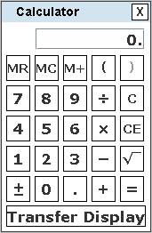
On-screen Calculator on the Computer-Based Test
Operated with the keyboard or mouse.
Has four arithmetic functions, square root, memory and parentheses.
Has a Transfer Display button to transfer a number to a Numeric Entry question (with a single answer box).
Respects order of operations (e.g., the result of 1 + 2 x 3 is 7, not 9).
Most questions do not require difficult computations, so the calculator should be used only when needed (e.g., larger numbers, long divisions or multiplications, square root, etc.).
8

Slide 9

A Closer Look at the Verbal Reasoning Sections
Assesses the test taker’s ability to understand what they read and how they apply their reasoning skills
Question types include
  Reading Comprehension
  Text Completion
  Sentence Equivalence
9

Slide 10
The Timed Test
During the timed test, test takers may work only on one section at a time and only for the time allowed
In any timed section, test takers may:
  Skip questions that they have difficulty answering and come back to them later before they exit the section
  Review questions they have already answered and change their answers before they exit the section
  Navigate forward and backward freely, at their discretion
Once a test taker has completed a section, they may not go back to it
10

Slide 11
More About the Verbal Reasoning and Quantitative Reasoning Sections
Section-level adaptive
The computer selects the second section of a measure based on a test taker’s performance on the first section
Within each section, all questions contribute equally to the test taker’s final score
Both sections are important, since the final score on each measure is based on the total number of correct answers and the level of difficulty of the questions
Myth buster!
Points are not deducted for wrong answers, so it is
ALWAYS better to guess than to leave an answer blank
11

Slide 12
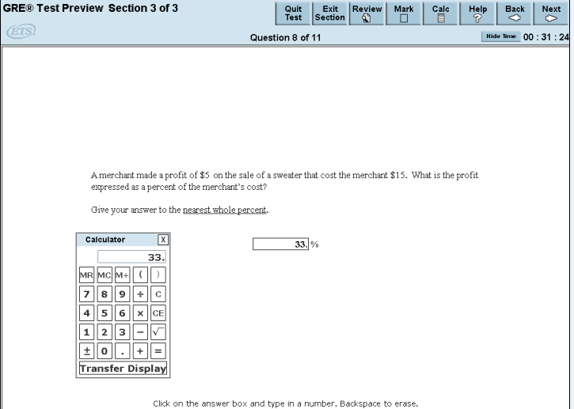
A Closer Look at the Test-taker Friendly Design
Move more freely within a section
An on-screen calculator
12

Slide 13
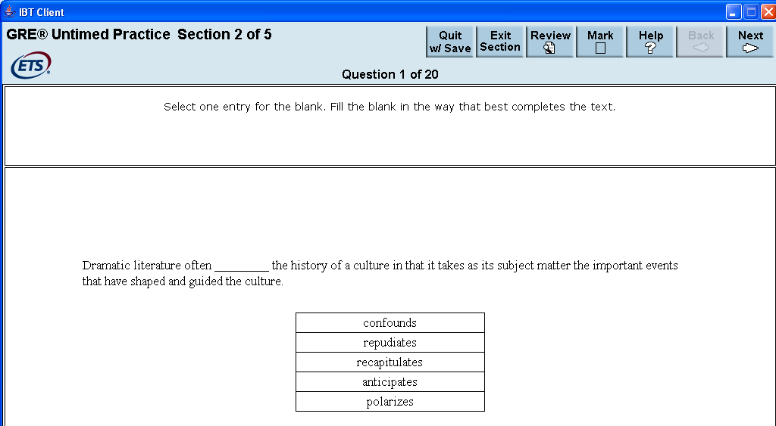
Mark and Review Features
“Mark” button
  Allows test takers to mark questions they would like to come back to later during the time provided to work on that section
“Review” button
  Allows test takers to view a list of the test questions in the section. The list contains each question number in the section, whether the test taker has answered the question, and whether the test taker has marked the question for review
13

Slide 14
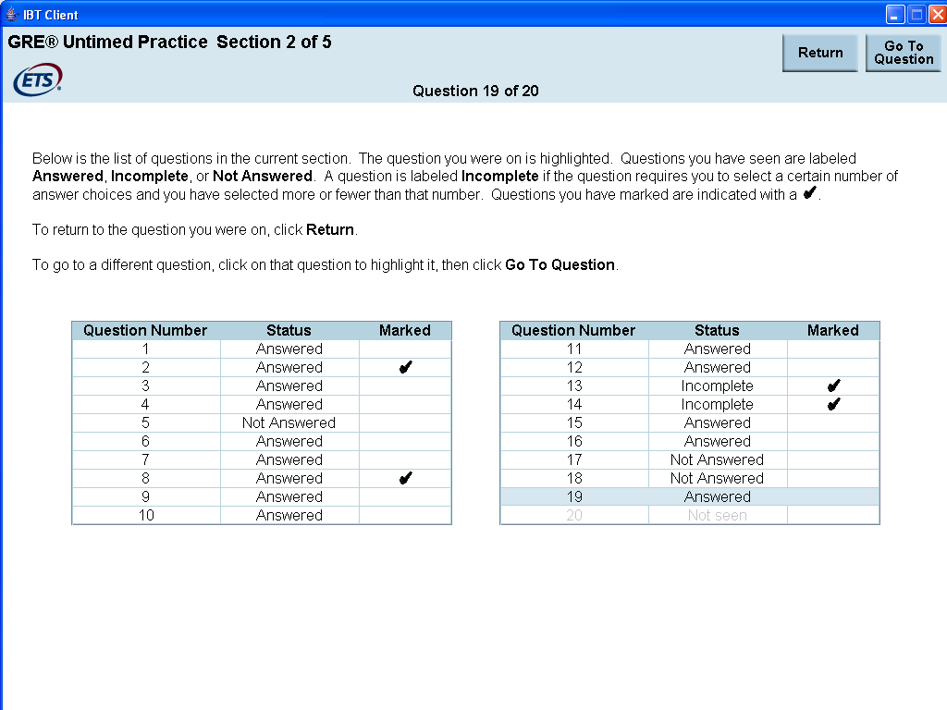
14

Slide 15

A Closer Look at the Analytical Writing Section
Assesses critical thinking and analytical writing skills
There are two writing tasks:
  Analyze an Issue — Requires the test taker to analyze an issue and develop an argument with reasons and/or examples to support their position
  Analyze an Argument — Requires the test taker to assess the logical soundness of a given argument according to the specific task directions.
Essay responses are typed on computer
  Basic functions include: insert text, delete text, cut and paste, and undo the previous action
15

Slide 16
Familiarization
On test day

Slide 17

On Test Day
Test takers should:
Get to the test center early
Be sure to bring their official ID documents that exactly match their registration or they may not be able to test
Follow the policies and procedures explained at ets.org/gre or in the Bulletin about what is allowed in the test center, test etiquette and more

Slide 18
Using Breaks Wisely
Breaks:
There is a 10-minute break after the third section
There is a one-minute break between the other sections
Good to Know:
If a test taker takes an unscheduled break the clock will not stop, so the best strategy is to proceed with the test without interruption once it begins
    Test takers might want to replenish their supply of
    scratch paper during a scheduled break

Slide 19
General Tips and Strategies
Test takers should
  Become familiar with question formats and directions beforehand.
  Be aware of time.
  Answer every question, even if they have to make a best guess.
  Check the review screen before finishing a section to ensure they have answered all questions.
Test takers should not:
  Waste time on questions they find extremely difficult, since no question carries greater weight than any other.
  Spend too much time on the review screen, as this will take away from the time they have to spend on the test questions.
19

Slide 20
General Tips and Strategies (continued)
Test takers may find the following strategy advantageous:
  Go through a section the first time quite rapidly, stopping only to answer those questions the test taker can answer with certainty, and marking those that require more thought
  Next, go back and spend time answering the questions marked for further review
  Finally, if there is time, go back and answer the questions that seemed to be the most difficult
20

Slide 21
What Test Takers Need to Bring to the Test Center
Test takers must have acceptable and valid ID with their name, signature and photograph to be admitted to a test center
  ID requirements are strictly enforced
Test takers should have the names of schools where they would like to send their scores
The following items are not allowed in the testing room:
  Food, drinks and tobacco
  Personal items other than identification documents
  Cell phones, smartphones (e.g., AndroidTM, BlackBerry®, iPhone devices), PDAs, digital watches, smartwatches, and other electronic, recording, listening, scanning or photographic devices
    Test takers may not access their phone during the test or during breaks to check messages or to check the time.
21

Slide 22
Before the Start of the Test
Photograph taken
Handwriting sample collected
Test takers receive a supply of scratch paper
  Test takers are able to replenish their supply of scratch paper, as necessary, throughout the entire test administration
  Scratch paper may not be taken from the test center
Testing room has proctors and electronic surveillance
22

Slide 23

Simulating the Actual Test Experience
Free POWERPREP® II Software can be downloaded from the GRE® website
It is as close to the actual computer-delivered test as you can get
  Provides two full-length practice tests, which students can use in a timed environment
  Allows students to see and try the functionality
  Also provides strategies and additional sample questions
For both PC and Mac OS® systems
ets.org/gre/prepare
23

Slide 24
Resources
ETS The Official Guide to the GRE revised General Test; 2nd Edition
ETS Official GRE Quantitative Reasoning Practice Questions
ETS Official GRE Verbal Reasoning Practice Questions
Install ETS Powerprep II: https://www.ets.org/gre/revised_general/prepare/powerprep2
ETS analytical writing examples: https://www.ets.org/gre/revised_general/prepare/analytical_writing/argument/sample_responses
Magoosh
  Ultimate guide
  GRE blog
  Math book
  Math flashcards: https://gre.magoosh.com/flashcards/math
  Vocab book
  Vocab flashcards: https://gre.magoosh.com/flashcards/vocabulary
  GRE Article of the Month http://magoosh.com/gre/?s=gre+article+of+the+month&submit.x=0&submit.y=0 and http://magoosh.com/gre/2015/gre-article-of-the-month-roundup/
Kaplan Free resources: http://www.kaptest.com/gre#freeprep (have to sign up)
  Free Question-a-day
  Free practice test
  20 min practice
Princeton Review Cracking the GRE with 4 Practice Tests, 2015
http://www.vocabulary.com/; http://freerice.com/#/english-vocabulary/1420

