Slide 1
GRE TEST prep
Quant Overview & Arithmetic
Beth Bowman, Ph.D.
VSSA GRE prep course

Slide 2
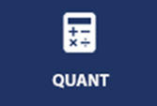
Quantitative Reasoning Question Types
Multiple Choice — Select One Answer Choice
  Five answer choices, choose the correct one
Multiple Choice — Select One or More Answer Choices
  Select one or more choices from a list
Quantitative Comparison Questions
  Compare two quantities
Numeric Entry Questions
  Enter a numerical answer in an answer box or boxes
Some questions are in Data Interpretation sets
  Several consecutive questions about the same data presentation
2

Slide 3
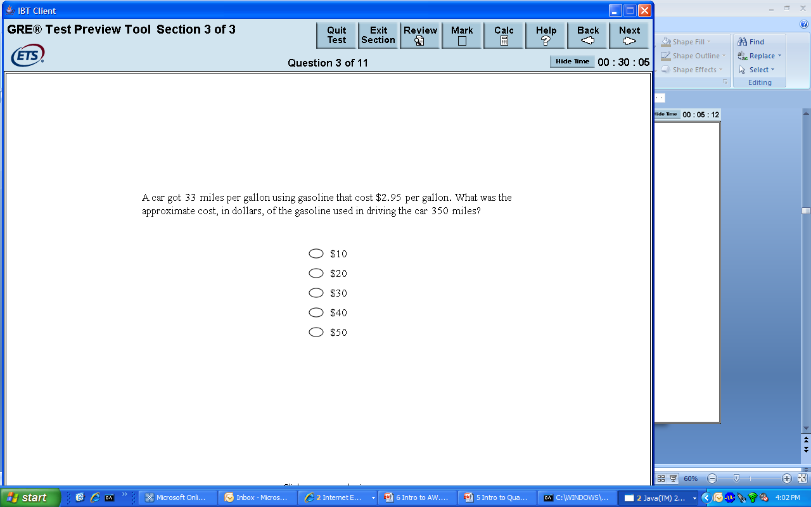
Multiple Choice — Select One Answer Choice
3

Slide 4
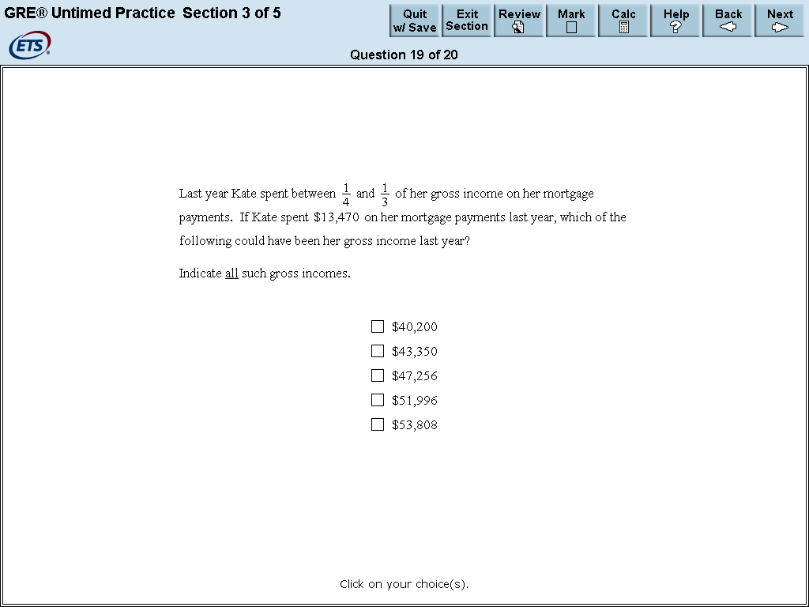
Multiple Choice — Select One or More Answer Choices
4

Slide 5
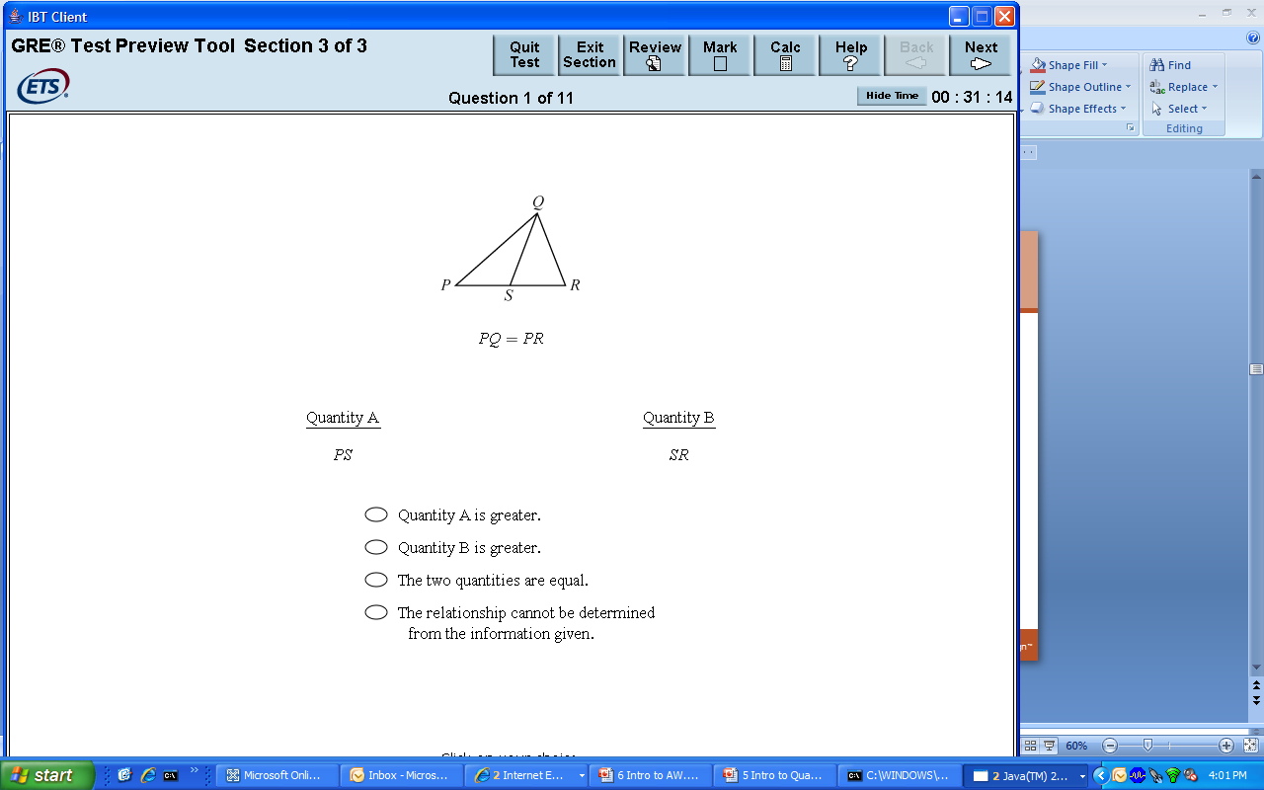
Quantitative Comparison Questions
5

Slide 6
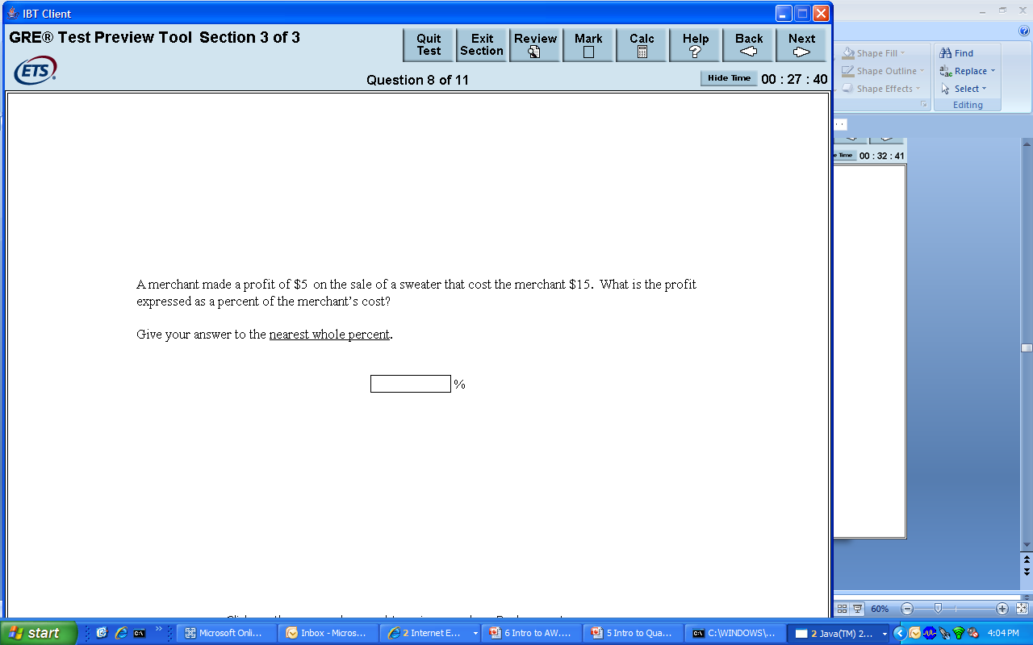
Numeric Entry Questions
6

Slide 7
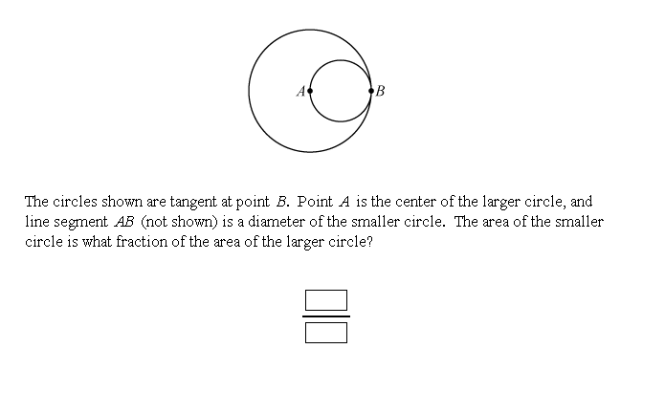
Numeric Entry Questions
7

Slide 8
Data Interpretation Questions
Data Interpretation questions are grouped together and refer to the same table, graph or other data presentation.
These questions ask test takers to interpret or analyze the given data.
The types of questions may be Multiple Choice (both types) or Numeric Entry.
8

Slide 9
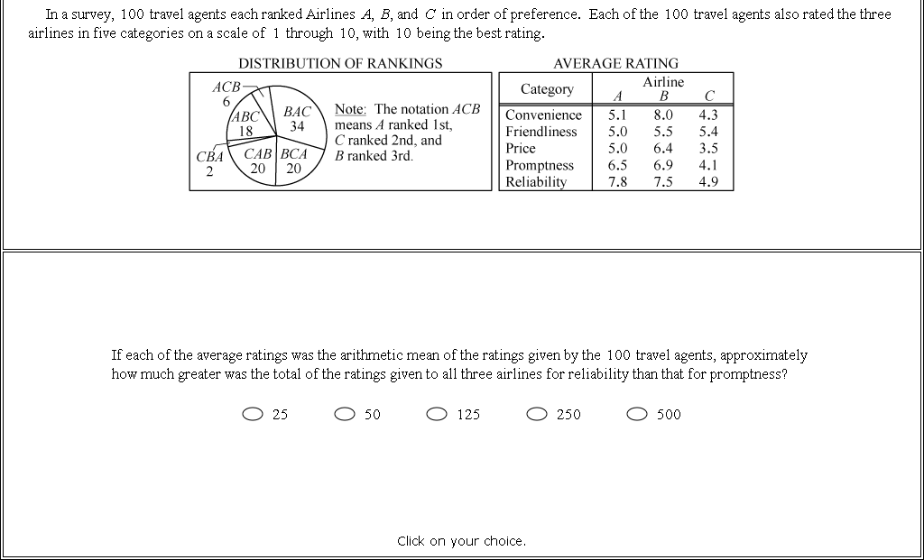
Data Interpretation Questions
9

Slide 10
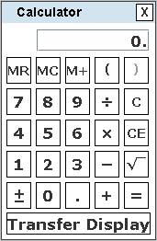
On-screen Calculator on the Computer-Based Test
Operated with the keyboard or mouse.
Has four arithmetic functions, square root, memory and parentheses.
Has a Transfer Display button to transfer a number to a Numeric Entry question (with a single answer box).
Respects order of operations (e.g., the result of 1 + 2 x 3 is 7, not 9).
Most questions do not require difficult computations, so the calculator should be used only when needed (e.g., larger numbers, long divisions or multiplications, square root, etc.).
10

Slide 11
Going through the test
Tips:
  Use scrap paper!
    For calculations; To keep track of where you are; For when you come back to a quest
  Two passes on test
    Go through and answer ones you know first then go through and answer ones you don’t know
    If you don’t know one, skip and move on. Clear your mind.
  Get out of La La Land
    You don’t know where to go; If you’re literally not doing anything
  Use scratch paper! For eliminating answers, for solving math
  On hard ones, use process of elimination
  Estimate and Ballpark an answer
  Avoid traps
  Last two minutes, answer all blank

Slide 12
Examples
Estimate
  A 100-foot rope is cut so that the shorter piece is 2/3 the length of the longer piece. How many feet long is the short piece?
    75
    66 2/3
    50
    40
    33 1/3
Avoid Traps
  The price of a jacket was reduced by 10%. During a special sale, the price was discounted another 10%. What is the total percentage discount from the original price of the jacket?
    15%
    19%
    20%
    21%
    25%

Slide 13
Tips for specific question types

Slide 14
Quant compare tips
Plug and chug
  FROZEN: fraction, repeats (numbers fro problem), one, zero, extremes (100), negative
Simplify the comparison
  Compare
    1/16 + 1/7 + 1/4 and 1/4 + 1/16 + 1/6
Algebraically compare the two sides
  Remember that multiplying or dividing by a negative number reverses the sign (we will talk more about this next time)
  Compare
    1+ w/(1+w) and 1+ 1/(1+w)

Slide 15
Other question types
Single answer
  Back-solve (with answers B and D)
  Estimate
    Scan answers to see how close you have to be
Multiple answer
  Read question: how many answers do you need to select
  If asking for possible values, determine least and highest possible values before selecting
  Estimate
Numerical Entry
  Enter answer as an integer or a decimal if there is a single answer box.
  Enter answer as a fraction if there are two separate boxes — one for the numerator and one for the denominator.
    Don’t reduce fractions, waste of time
  Enter the exact answer unless the question requires you to round answer.
    If rounding, round to the required degree of accuracy
  Examine their answer to see if it is reasonable

Slide 16
Areas of Knowledge

Slide 17
Arithmetic Topics: terminology
Integer (includes 0); consecutive integers
Adding, multiplying odds and evens
  ETS 154 14. On the number line shown above, the tick marks are evenly spaced. Which of the following statements about the numbers x, y, and z must be true?
  Indicate all such statements:
    xyz < 0
    x + z = y
    z(y – x) > 0
Factors (divide into a number), multiple
Prime number (2, 3, 5, 7, …); prime factorization
Undefined: x/0, √(neg #), 0⁰
Terms
  Sum, difference, product, quotient, divisor, numerator, denominator, consecutive
Rules for deciding if a number is divisible by 2, 3, 4, 5, 6, 8, 9
x
0
y
z

Slide 18
Arithmetic Topics: Extra tips on dividing
http://www.quickanddirtytips.com/education/math/how-to-tell-if-a-number-is-divisible-by-7-8-or-9
7
  Double last digit of number
  Subtract from the rest of the digits
  If 0 or divisible by 7, then divisible by 7
8
  Last three digits divisible by 8?
  For 3-digit #s:
    If first digit is even and the last two digits are divisible by 8, it is divisible
    If first digit is odd, subtract 4 from last two digits and if it is now divisible by 8, the whole number is divisible

Slide 19
Arithmetic Topics: Exponents
a²*a³=a⁵
(a²)³=a⁶
a²/a³=a²⁻³=a⁻¹
a³-a²=a²(a-1)
  Compare:
    27⁴ and 9⁶
  If 3³ x 9¹² = 3^{x}, what is the value of x?
a⁻³= 1/a³
General rules:
  Negative number raised to even power makes it positive
  Odd number raised to any power is still odd
  Raising a number >1 to a power >1 makes the number bigger
  Raising a number between 0 and 1 to a power >1 makes the number smaller

Slide 20
Arithmetic Topics: Exponents
ETSQ 46 5: n is an even negative integer
  Compare
    (1/3)^{n}
    (-3)^{n}
ETSQ 49 15: If |z| ≤ 1, which of the following statements must be true? Indicate all such statements
  z² ≤ 1
  z² ≤ z
  z³ ≤ z

Slide 21
Arithmetic Topics: sqrt
√100 = 10; -√100 = -10
  √25 = ?
  √36 = ?
  √32 = ?
(√a) (√b) = (√ab)
  √32 = √(16*2) = 4√2
  (√75)/(√27) = ?
(√a)/(√b) = √(a/b)
√a + √a = 2√a
√a + √b ≠ √(a+b)
For odd order roots, there is 1 answer; for even order roots, there are 2

Slide 22
Arithmetic Topics: Fractions etc
Fractions
  Always reduce (except for data entry questions)
  a/b + c/b = (a+c)/b
  a/b - c/b = (a-c)/b
  a/b * c/d = (ac)/(bd)
  a/b ÷ c/d = (ad)/(bc)
Converting fractions to percentages to decimals to ratios to proportions
  Tip: ratio or 1:2 means that total is a multiple of 3
  Tip: ratio box
  You have a handful of pennies and nickels in a ratio of 2:1. You have a total of 24 coins. How many pennies do you have?
 | Pennies | Nickels | Total
ratio | 2 | 1 | 3
Multiply by
Actual numbers |  |  | 24

Slide 23
Arithmetic Topics: Fractions etc
PR 238. Flour, eggs, yeast, and salt are mixed by weight in the ratio of 11:9:3:2, respectively. How many pounds of yeast are there in 20 pounds of the mixture?
  1 3/5
  1 4/5
  2
  2 2/5
  8 4/5

Slide 24
Arithmetic Topics: Fractions etc
Percent Increase/Decrease
  =difference/original * 100
    IE if it doubles, then it is a 100% increase.
  PR 233. Vandelay Industries reported a $6,000 profit over the three-month period from March to May of the current year. If, over the previous the previous three-month period, Vandelay Industries realized a $3,500 profit, by approximately what percent did its profit increase?
    25%
    32%
    42%
    55%
    70%

Slide 25
Arithmetic Topics: Fractions etc
PR 234. The table shows the original price and the sale price for six different models of cars. For which car models is the discount between the original price and the sale price at least 25%?
Indicate all such models
  A
  B
  C
  D
  E
  F
Model | Original Price | Sale Price
A | $12,000 | $9,500
B | $16,000 | $13,000
C | $10,000 | $7,500
D | $17,500 | $13,000
E | $20,000 | $15,500
F | $22,000 | $16,000

Slide 26
Arithmetic Topics: Probability
Probability: # possible outcomes to satisfy condition/#total possible
  Series: multiply two events
    Probability of flipping two heads?
    Probability of flipping two of the same side of the coin?
  OR: add two events
    Probability of selecting either 7 or 4 from a deck of cards?
Permutations and combinations to come…

Slide 27
Arithmetic Topics: Probability
PR 303: Julie is going to roll a pair of six-sided dice. What is the probability that she rolls either a 3 and a 4, OR a 5 and a prime number?
  /
PR 304: Dipak has a 25% chance of winning each hand of blackjack he plays. If he has $150 and bets $50 a hand, what is the probability that he will still have money after the third hand?
  1/64
  3/16
  27/64
  37/64
  3/4
Notes:
1/36 + (1/6*1/2) = 1/36 + (1/12) = 1/36 + 3/36 = 4/36 = 1/9
¾ * ¾ * ¾ = 27/64. (64-27)/64 = 37/64

Slide 28
Arithmetic Topics: Probability
PR 315 9. A jar contains 12 marbles. Each is either yellow or green and there are twice as many yellow marbles as green marbles. If two marbles are to be selected from the jar at random, what is the probability that exactly one of each color is selected?
  8/33
  16/33
  1/2
  17/33
  25/33
Notes:
8 y, 4 g
8/12 * 4/11 + 4/12 * 8/11
8/33 + 8/33
16/33

Slide 29
Arithmetic Topics: Statistics
Average
  Think about this:
  You take 3 tests, average 90. If your score goes up to 91 after the 4th test, what did you sore on the 4th test?
  The average of 100 measurements is 23; the average of 50 more is 27. What is the average of all?
  If a ≤ b ≤ c ≤ d ≤ e ≤ 110 and average of a-e is 100, what is least possible value of a?
Median (if even # of #s, it is the average of the middle two), mode, range

Slide 30
Arithmetic Topics: Statistics
List X
Number | 1 | 2 | 3 | 5
Frequency | 10 | 20 | 18 | 12
  ETS 150 2: List X and list Y each contain 60 numbers. Frequency distributions for each list are given above. The average of the numbers in the list X is 2.7 and the average of the numbers in list Y is 7.1. List Z contains 120 numbers: the 60 numbers in list X and the 60 numbers in list Y. Compare:
    The average of the 120 numbers in list Z
    The median of the 120 numbers in list Z
List Y
Number | 6 | 7 | 8 | 9
Frequency | 24 | 17 | 10 | 9

Slide 31
Arithmetic Topics: Factorials
Factorials
  6! = 6*5*4*3*2*1
  PR 305: Compare
  12!/11! And 4!/2!

Slide 32
Review; hard questions
PR 315 6: Lee randomly selects a 2-digit prime number less than 50. What is the probability that the tens digit is greater than the units digit?
  3/14
  3/11
  3/8
  1/2
  8/11
ETS 156 3: x is an integer greater than 1
  Compare
    3^{x + 1}
    4^{x}

Slide 33
Review; hard questions
ETS 160 15: The range of heights of the female students in a certain class is 13.2 inches, and the range of the heights of the male students in the class is 15.4 inches.
Which of the following statements individually provide(s) sufficient additional information to determine the range of heights of all of the students in the class?
Indicate all such statements
  The tallest male student in the class is 5.8 inches taller than the tallest female student in the class.
  The median height of the male students in the class is 1.1 inches greater than the median height of the female students in the class.
  The average height of the male students in the class is 4.6 inches greater than the average height of the female students in the class.

Slide 34
Review; hard questions
PR 262 17: One ounce of Solution X contains only ingredients a and b in a ratio of 2:3. One ounce of Solution Y contains only ingredients a and b in a ratio of 1:2. If Solution Z is created by mixing solutions X and Y in a ratio of 3:11, then 630 ounces of Solution Z contains how many ounces of a?
  68
  73
  89
  219
  236
K 259 4: The cost of a shirt is x dollars. Compare
  x
  The cost of the shirt if the original cost is first increased by 10% and then decreased by 10%

Slide 35
Review; hard questions
PR 260 10: Towns A, B, C, and D are all in the same voting district. Towns A and B have 3,000 people each who support referendum R and the referendum has an average of 3,500 supporters in towns B and D and an average of 5,000 supporters in Towns A and C
  Compare
    The average number of supporters of Referendum R in Towns C and D
    The average number of supporters of Referendum R in Towns B and C
ETS 156 6: Set S consists of all positive integers less than 81 that are not equal to the square of an integer
  Compare
    The number of integers in set S
    72

