Slide 1
GRE TEST prep
Quantitative Reasoning Topics
Beth Bowman, Ph.D.
VSSA GRE prep course

Slide 2

Strategies for Data Interpretation Questions
Test takers should scan the data presentation briefly to see what it is about, but not spend time studying all of the information in detail.
Bar graphs and circle graphs, as well as other graphical displays of data, are drawn to scale, so test takers can read or estimate data visually from such graphs.
The questions are to be answered only on the basis of the data presented, everyday facts (such as the number of days in a year), and the test taker’s knowledge of mathematics.
2

Slide 3
Data Interpretation
Slow down! These questions will probably take the most time
Read titles, axis, scales, key
If two graphs, usually first question involves 1 graph but others involve both
Break the wordy questions down
Content
  Quartiles
  Box and whiskers box (box = Q2-3; whiskers = Q1-4)
  Percent Increase/Decrease
    =difference/original * 100
      IE if it doubles, then it is a 100% increase.

Slide 4
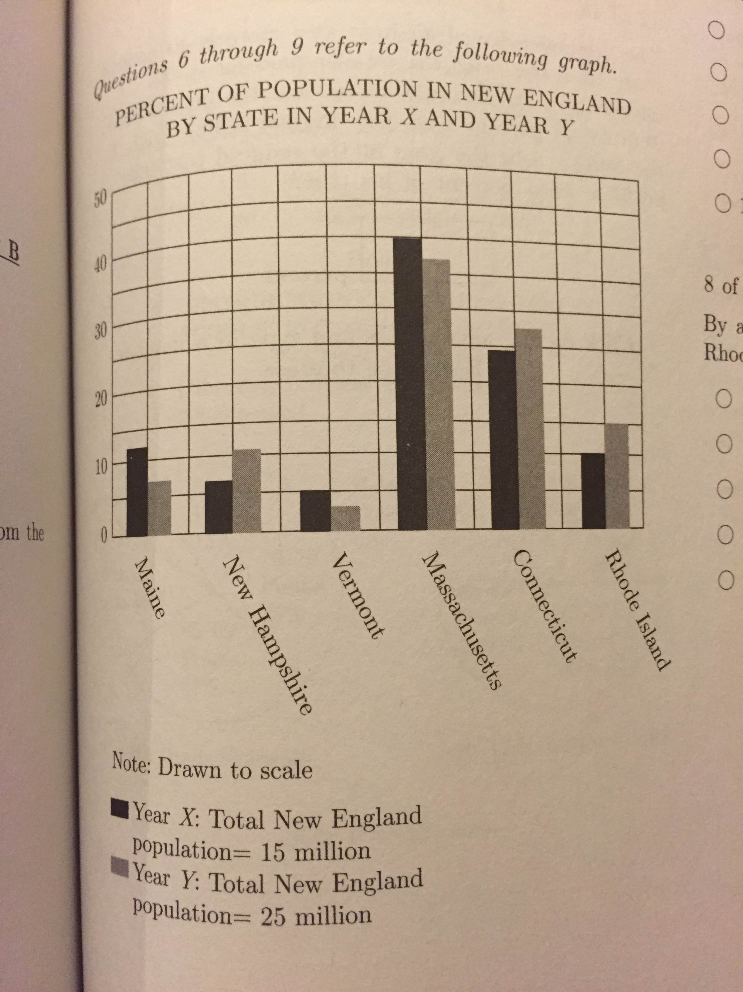
Data Interpretation Qs
PR 259: If the six New England states are ranked by population in Year X and Year Y, how many states would have a different ranking from Year X to Year Y?
  0; 1; 2; 3; 4
In year X, the population of Massachusetts was approximately what percent of the population of Vermont?
  50; 120; 300; 800; 1200
By approximately how much did the population of Rhode Island increase from Year X to Year Y?
  750,000
  1,250,000
  1,500,000
  2,250,000
  3,375,000

Slide 5
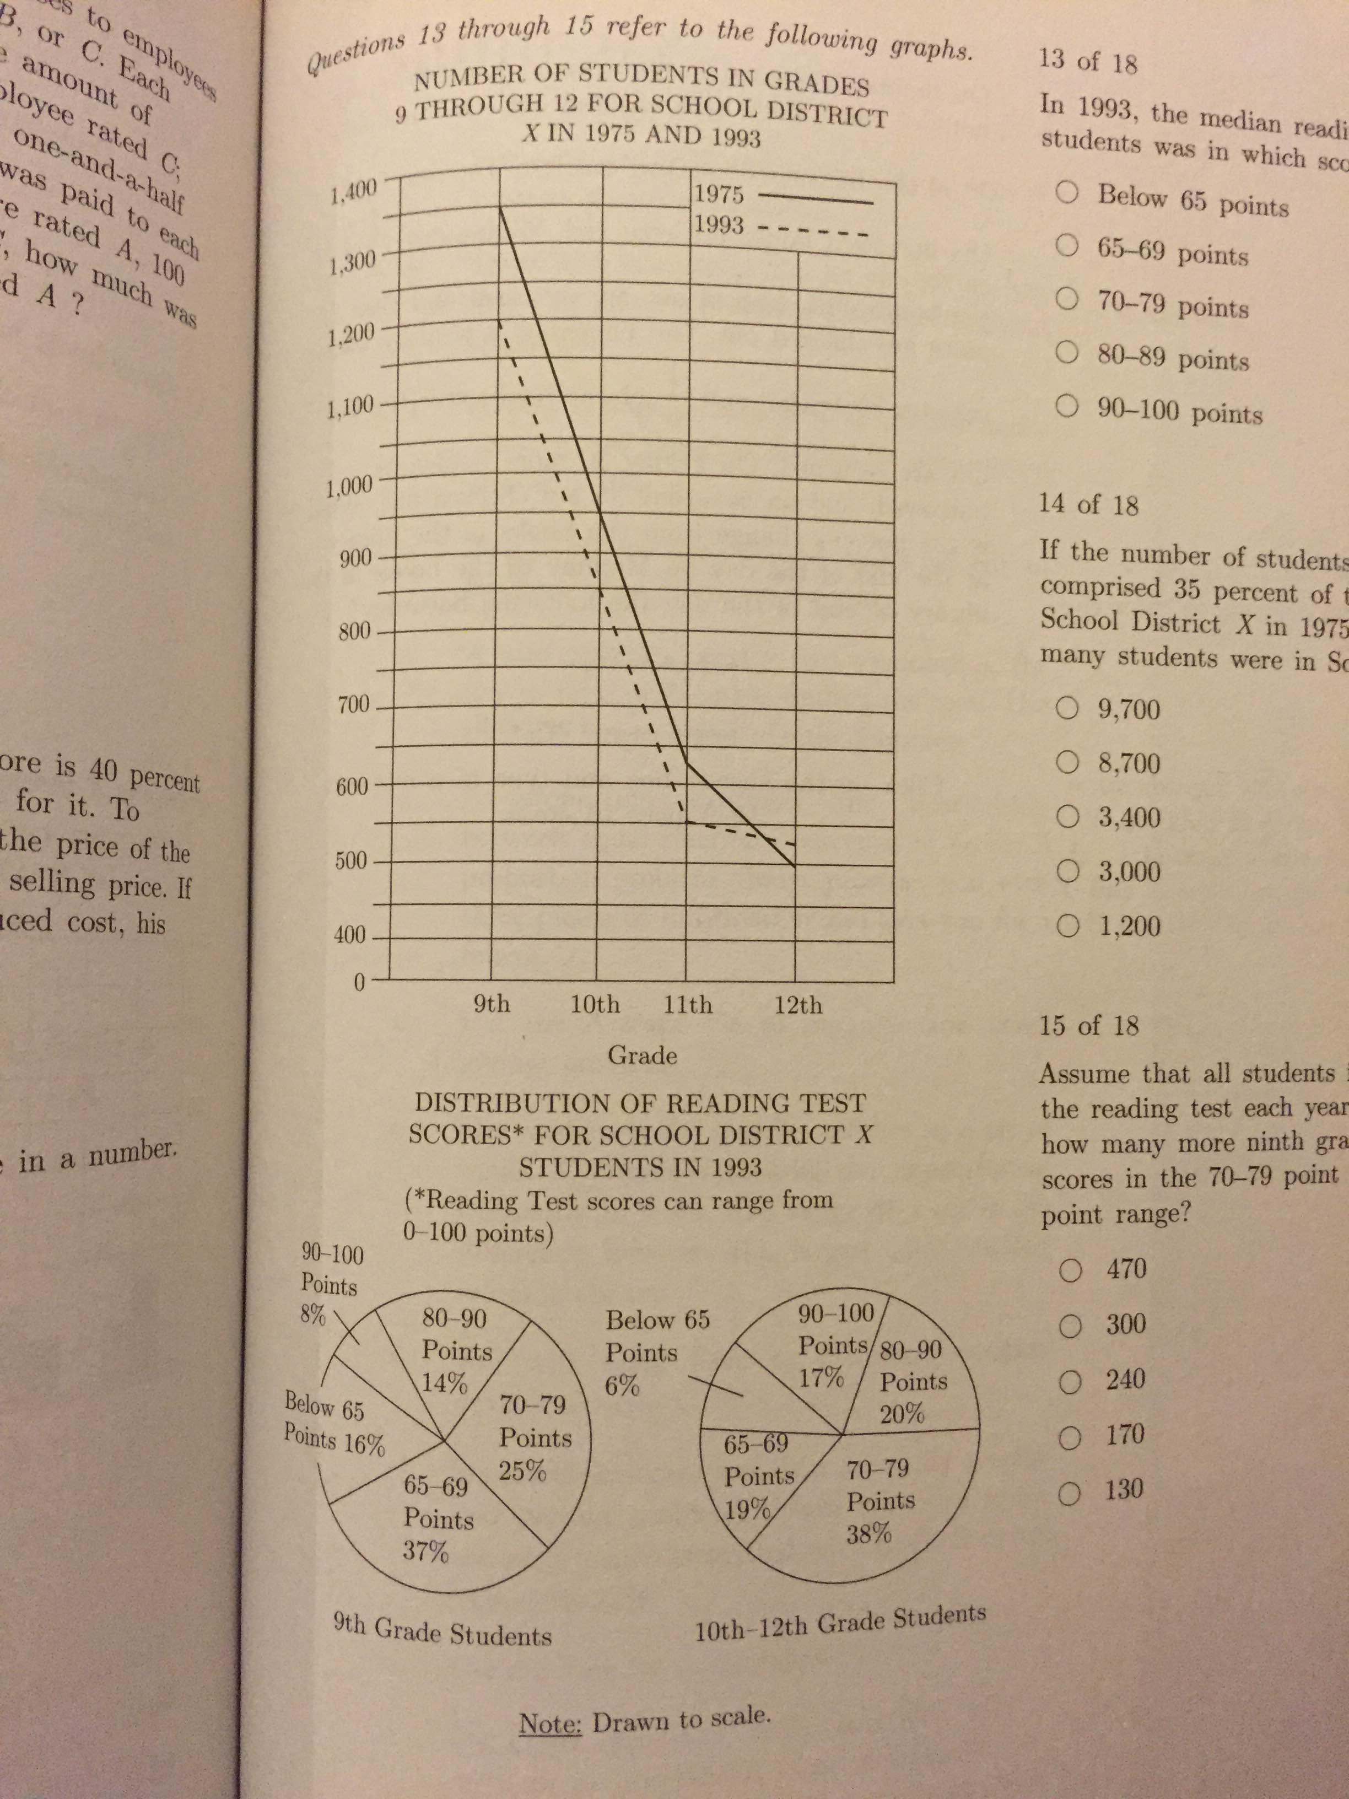
Data Interpretation Qs
PR 261 13: In 1993, the median reading test score for ninth grade students was in which score range?
  Below 65 points
  65-69 points
  70-79 points
  80-89 points
  90-100 points
If the number of students in grades 9 through 12 comprised 35 percent of the number of students in School District X in 1975, then approximately how many students were in School District X in 1975?
  9,700; –8,700; –3,400; –3,000; –1,200
Assume that all students in School District X took the reading test each year. In 1993, approximately how many more ninth grade students had reading test scores in the 70-79 point range than in the 80-89 point range?
  470; –300; –240; –170; –130

Slide 6
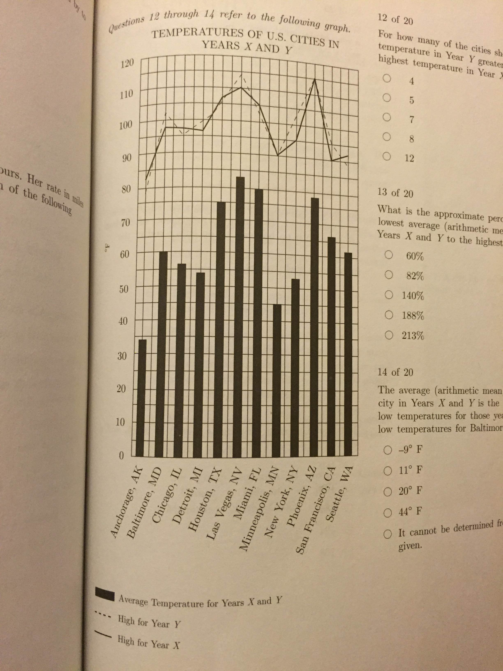
Data Interpretation Qs
PR 319: For how many of the cities shown was the highest temperature in Year Y greater than or equal to the highest temperature in Year X?
  4; –5; –7; –8; –12
What is the approximate percent increase from the lowest average (arithmetic mean) temperature for Years X and Y to the highest average temperature?
  60%; –82%; –140%; –188%; –213%
The average (arithmetic mean) temperature for any city in Years X and Y is the average of the high and low temperatures for those years. What is the average low temperatures for Baltimore for Years X and Y?
  -9°F
  11°F
  20°F
  44°F
  It cannot be determine from the info given

Slide 7
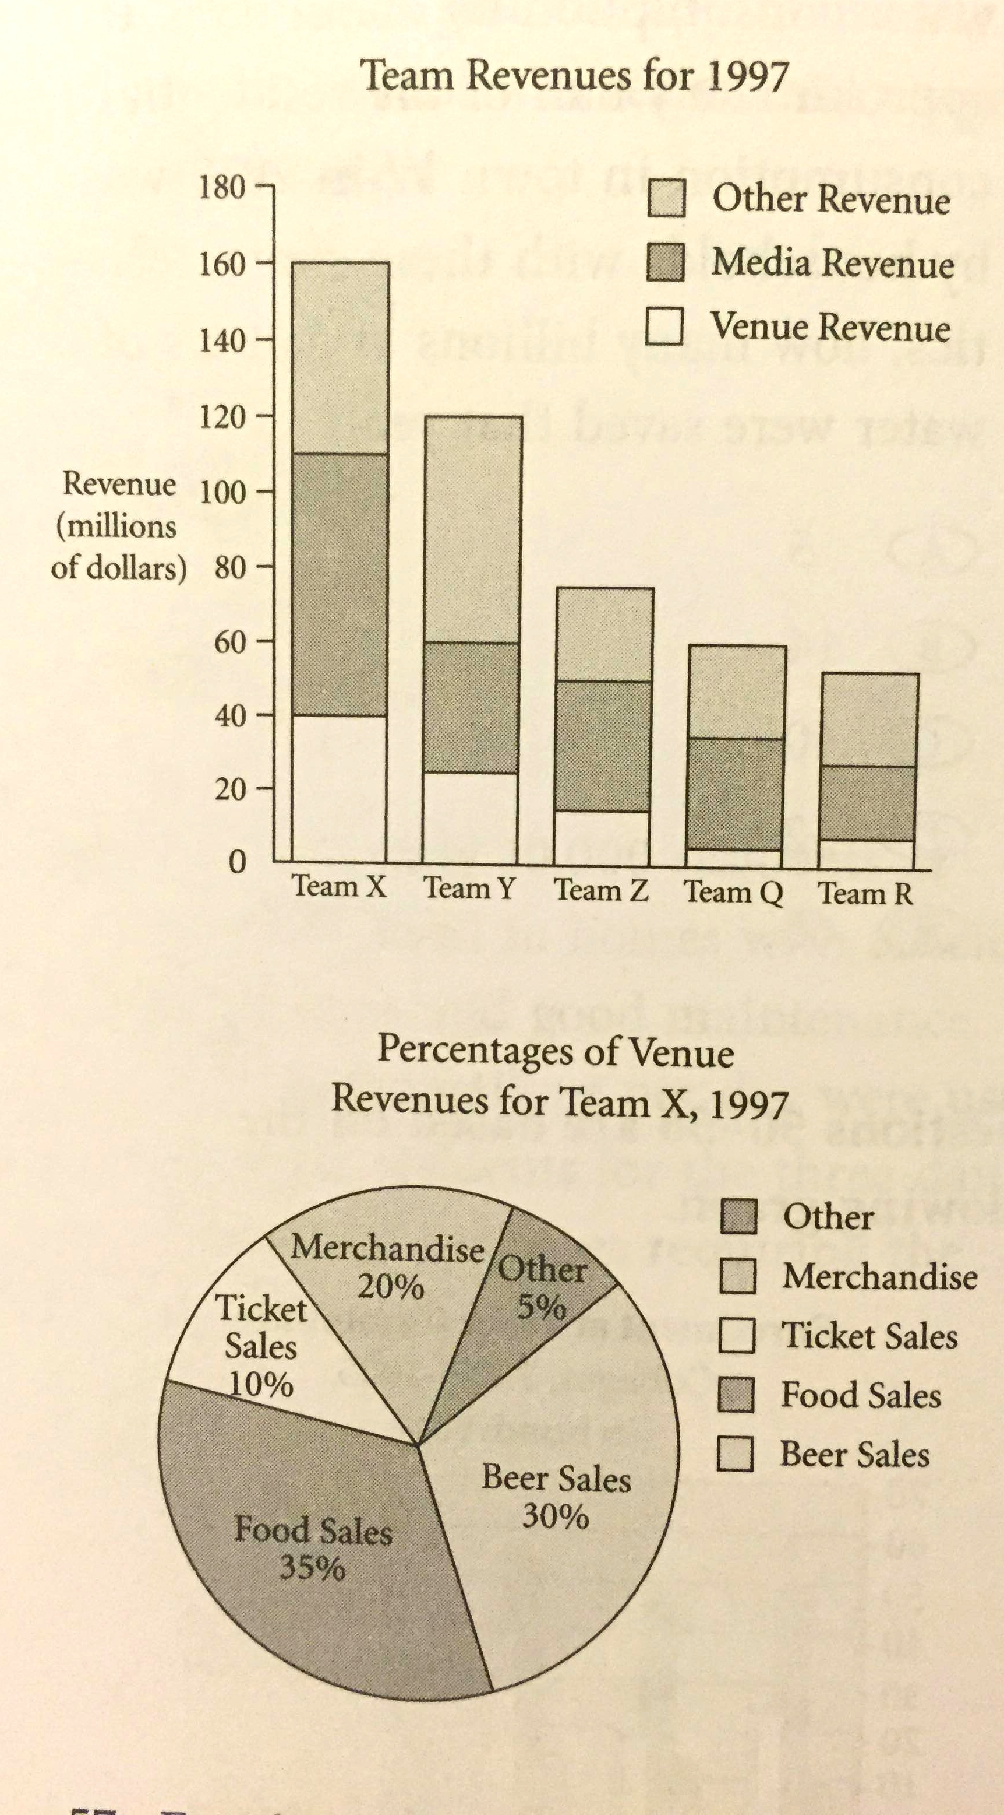
Data Interpretation Qs
K 270: For the team with the median amount of venue revenue for 1997, media revenue represented approximately what percent of that team’s total revenue for that year?
  25%; –30%; –40%; –55%; –60%
In 1997, which teams had media revenues less than $25 million? Indicate all such teams
  Team X
  Team Y
  Team Z
  Team Q
  Team R
If Team Y earned total revenues of $150 million or greater in 1998, Team Y’s total revenue increased by approximately what percent from 1997 to 1998? Indicate all such percents
  20%; –25%; –30%; –35%; –40%

Slide 8
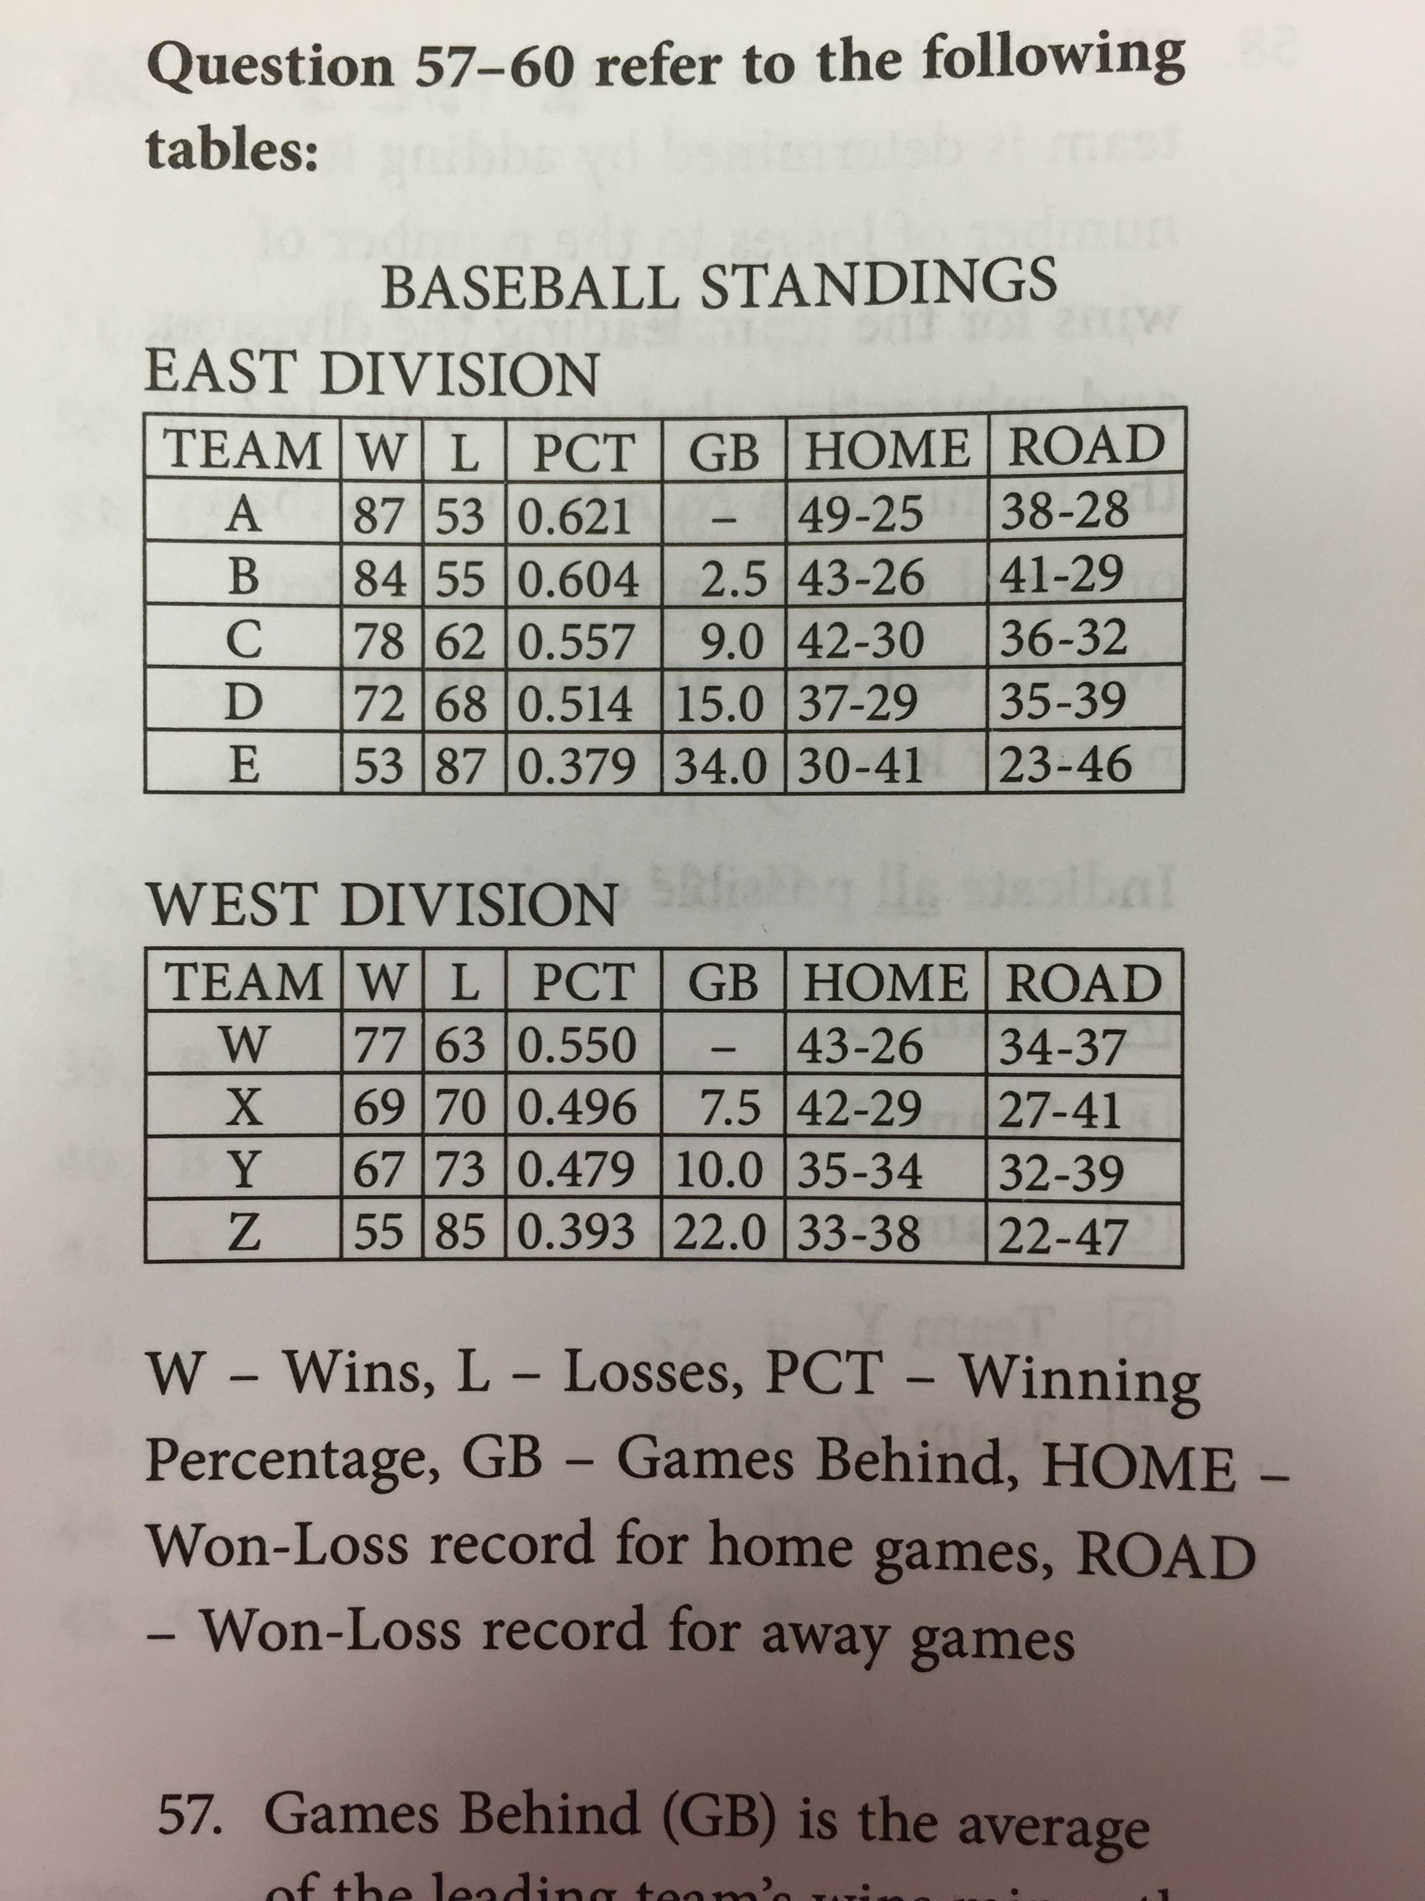
Data Interpretation Qs
K 301: Games Behind (GB) is the average of the leading team’s wins minus the trailing team’s wins and the trailing team’s losses and the leading team’s losses. If Team W were in the East Division, how man games would it be behind Team A?
  8; – 8.5; – 9; – 9.5; – 10
The elimination Number for any team is determined by adding its number of losses to the number of wins for the team leading the division, and subtracting that total from 163. If the Elimination Number
is less than or equal to 0, a team is eliminated. Which team has an elimination number less than 5? Indicate all possible choices.
  Team C
  Team D
  Team E
  Team Y
  Team Z

Slide 9
Data Interpretation Qs
If Team W were in the East Division, which place would it be in?
  First
  Second
  Third
  Fourth
  Fifth
Which team has the best win-loss percentage for road games?
  Team A
  Team B
  Team C
  Team W
  Team X

Slide 10
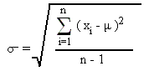
Pseudo Statistics
Bell curve: 2, 14, 34% between standard deviations
Standard deviation equation:
PR 249: Compare
  The standard deviation of a list of data consisting of 10 integers ranging from -20 to -5
  The standard deviation of a list of data consisting of 10 integers ranging from 5 to 20
PR 250: The fourth grade at School x is made up of 300 students who have a total weight of 21,600 pounds. If the weight of these fourth graders has a normal distribution and the standard deviation equals 12 pounds, approximately what percentage of the fourth graders weighs more than 84 pounds?
  12%
  16%
  36%
  48%
  60%

Slide 11
Permutations & Combinations
Permutations: Order matters:
  Arrangements, orders, schedules, lists
  Number of ways 4 books can be arranged: 4!
  Permutations of n objects taken k at a time: (n!)/(n-k)!
  5 runners, 3 metals; How many different orders of winners can there be? 5*4*3
Combinations: Order doesn’t matter
  Groups, teams, committees
  #permutations/#ways to order: n choose k: (n!)/[(k!)(n-k)!]
    5 flavors of IC, you pick 3. # combinations?
    =5!/[3!(5-3)!]
First, does order matter? Then compare number of possibilities with number of slots

Slide 12
P & C Qs
PR 314 4: At a recent dog show, there were 5 finalists. One of the finalists was awarded “Best in Show” and another finalist was awarded “Honorable Mention.” In how many ways could the two awards be given out?
PR 308: Brooke wants to hang three paintings in a row on her wall. She has six paintings to choose from. How many arrangements of paintings on the wall can she create?
  6
  30
  90
  120
  720
PR 309: A pizza may be ordered with any of eight possible toppings. Compare
  The number of different ways to order a pizza with three different toppings
  The number of different ways to order a pizza with five different toppings

Slide 13
P & C Qs
PR 315 7: An elected official wants to take five members of his staff to an undisclosed secure location. How many staff members must the elected official employ in order to have a minimum of 20 different groups to choose from?
  7
  8
  9
  10
  11
PR 315 10: A set of 10 points lies in a plane such that no three points are co-linear. Compare
  The number of distinct triangles that can be created from the set
  The number of distinct quadrilaterals that can be created from the set

Slide 14
Hard P & C questions
K 292 16: Compare
  The number of distinct combinations that can be made by arranging all of the letters in the word “square”
  The number of distinct combinations that can be made by arranging all of the letters in the word “circle”
  PR 310: Nicole needs to form a committee of 3 from a group of 8 research attorneys to study possible changes to the Superior Court. If two of the attorneys are too inexperienced to serve together on the committee, how many different arrangements of committees can Nicole form?
    20
    30
    50
    56
    336
  PR 320 19: Six children, three boys and three girls, sit in a row on a park bench. How many arrangements of children are possible if no boy can sit on either end of the bench? Indicate all such values
    46,656
    38,880
    1,256
    144
    38

Slide 15
Review Qs
PR 317 5: At a dog show, there are 20 judges and 10 dogs in the final round. Compare
  The number of distinct pairs of judges
  The number of possible rankings of dogs from first to third place
  K 259 1: Compare
    The number of distinct ways to form a line of 3 people by choosing from 6 people, where order matters
    The number of distinct ways to form a line of 3 people by choosing from 10 people, where order does not matter
  ETS 156 5: The random variable X is normally distributed. The values 650 and 850 are at the 60th and 90th percentiles of the distribution of X, respectively. Compare
    The value at the 75th percentile of the distribution of X
    750

Slide 16
Review Qs
  ETS Q 111 11: Each of the following linear equations defines y as a function of x for all integers x from 1 to 100. For which of the following equations is the standard deviation of the y-values corresponding to all the x-values the greatest?
    y = (x/3)
    y = (x/2) + 40
    y = x
    y = 2x + 50
    y = 3x -20
ETS 157 7: A manager is forming a 6-person team to work on a certain project. From the 11 candidates available for the team, the manger has already chosen 3 to be on the team. In selecting the other 3 team members, how many different combinations of 3 of the remaining candidates does the manager have to choose from?
  6
  24
  56
  120
  264

